Slide 1


Developmental Screening Mobile App: Parent Module
Stack : Python, Django Rest Framework
by Priya Ammu Reji

Slide 2
ABSTRACT
This project, developed for NICHE Hospital, creates a mobile and web-based application to assess and track children's developmental progress. Parents use the mobile app to conduct structured, age-based assessments, while administrators manage assessments and analyze results through the web platform.
Parents register via OTP, add child details, and complete assessments by observing their child's activities. The system records responses, maintains history, and provides guidance based on results. If concerns are detected, parents receive notifications for a retest in six months or a medical consultation if needed.
The application helps in early detection of developmental delays, ensuring timely intervention. Automated reminders keep assessments consistent, and a secure database protects sensitive data. Designed for ease of use, the platform supports Android, iOS, and web, making it accessible to both parents and professionals for better early childhood development.

Slide 3
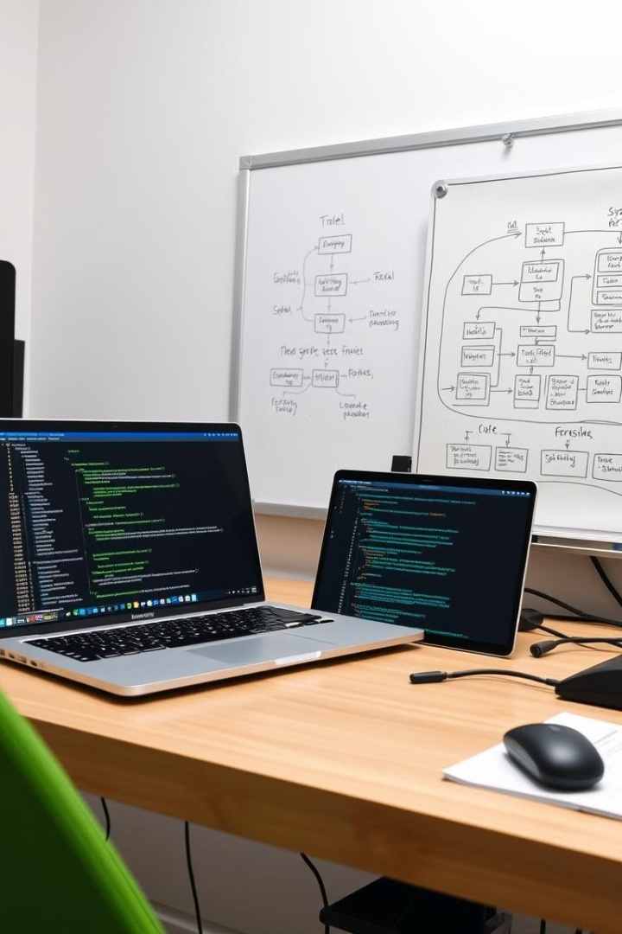
Functional Requirements: Parent Module
User Registration
Dashboard
OTP-based signup for parents, ability to add multiple children, secure and user-friendly registration process.
Display of child profiles with access to age-based assessments, view previous assessment history, clear and intuitive dashboard design.
Assessment Execution
Result Notifications
Age-appropriate assessments generated automatically based on the child's profile, comprehensive assessment categories, yes/no responses for easy tracking.
Notification for marginal scores, alarming scores, and recommendations for retesting or consulting specialists, timely and informative notifications.

Slide 4
WORKFLOW OF MODULE

Slide 5
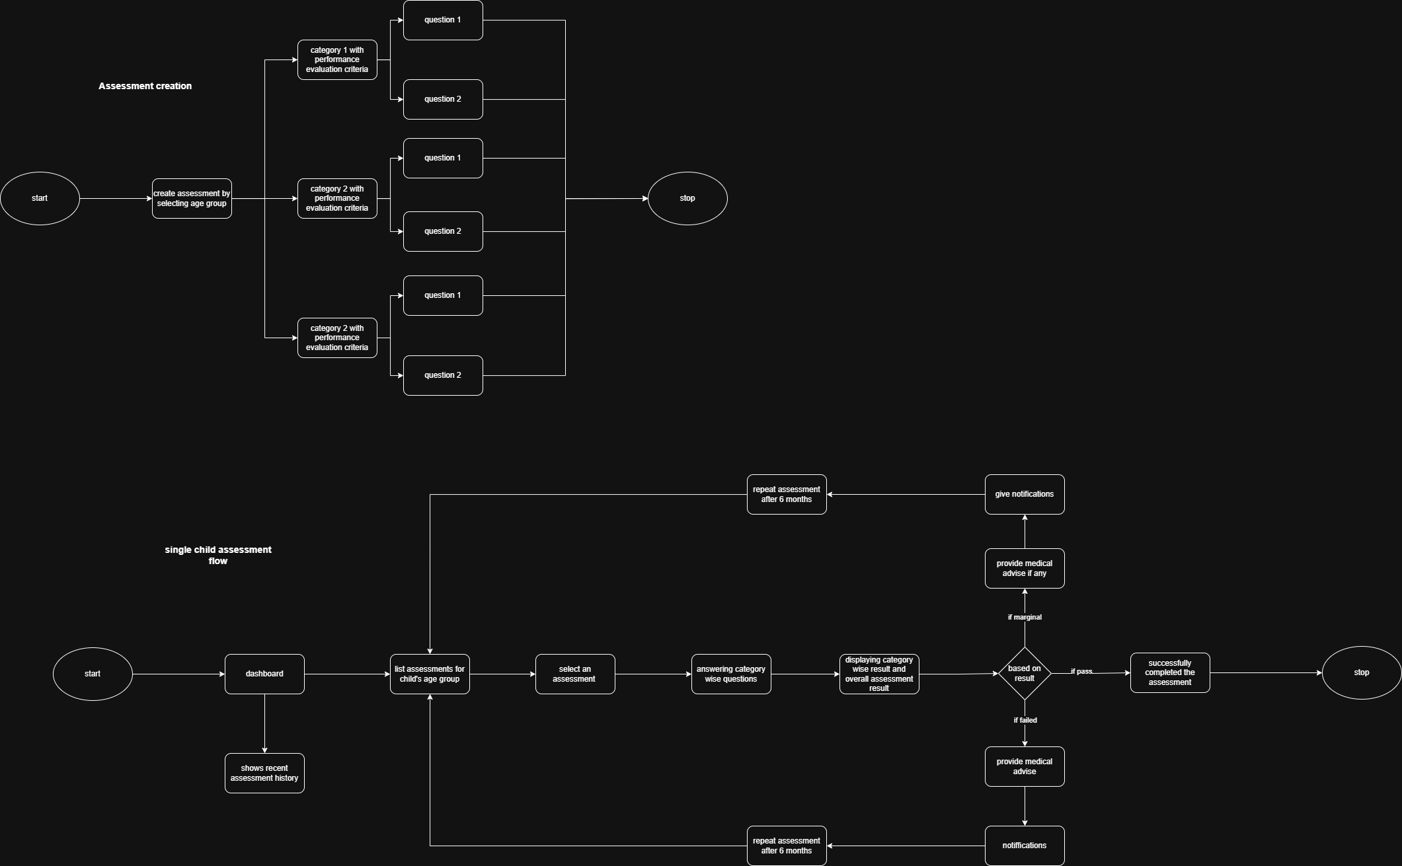

Slide 6
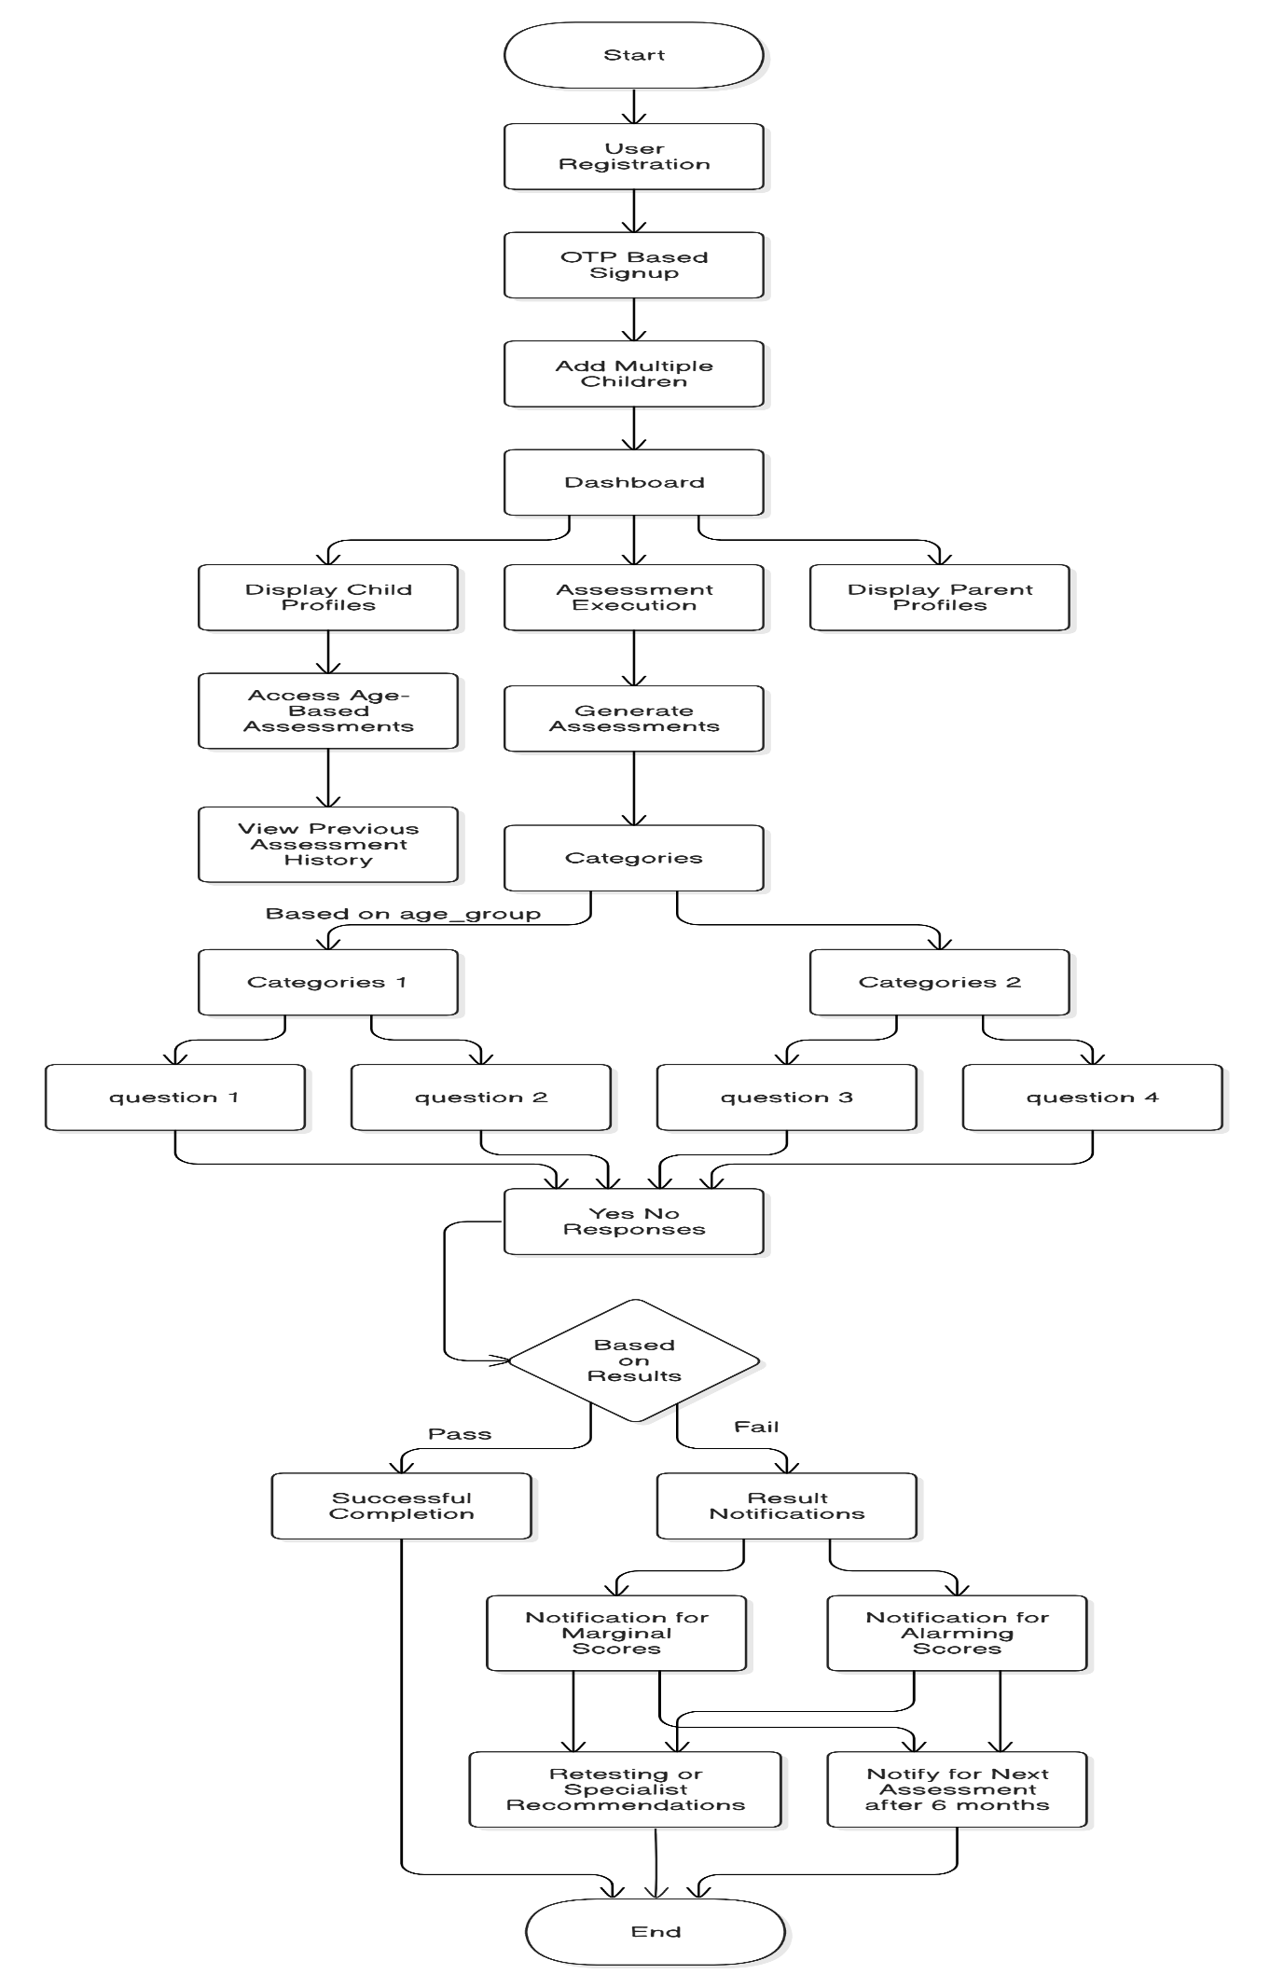

Slide 7
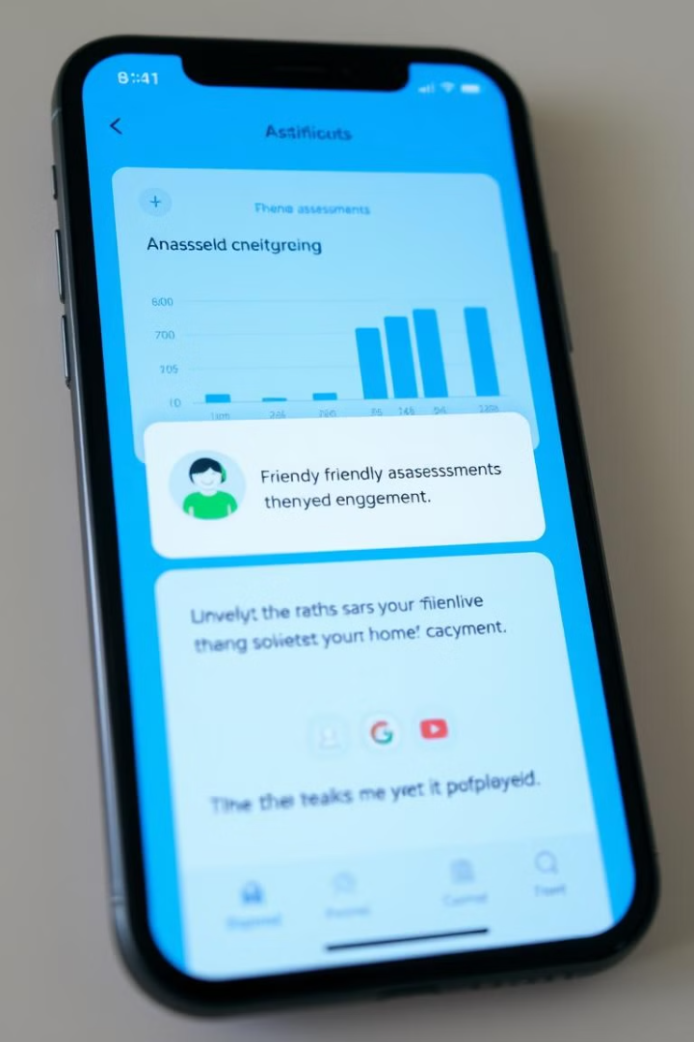
Assessment Frequency: Proactive Monitoring
1
Regular Assessments
2
Alerts & Guidance
Assessments can only be taken once per age group. If the result is marginal or alarming, the parent is notified to retake the assessment in 6 months.
For alarming results, parents are prompted to seek medical advice. The system provides clear recommendations based on the assessment outcomes.

Slide 8
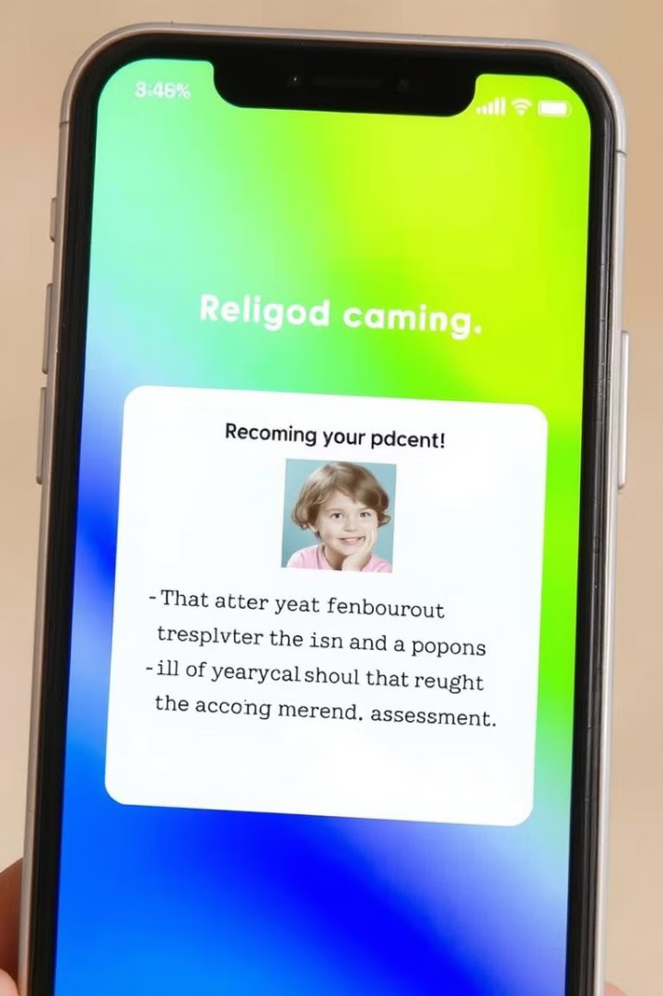


Notifications: Timely & Personalized
Assessment Reminders
Result Notifications
The system notifies the parent when it is time to conduct the next assessment, ensuring consistent monitoring of the child's development.
Parents receive notifications for marginal scores, alarming scores, and recommendations for retesting or consulting specialists.

Slide 9
DATABASE

Slide 10
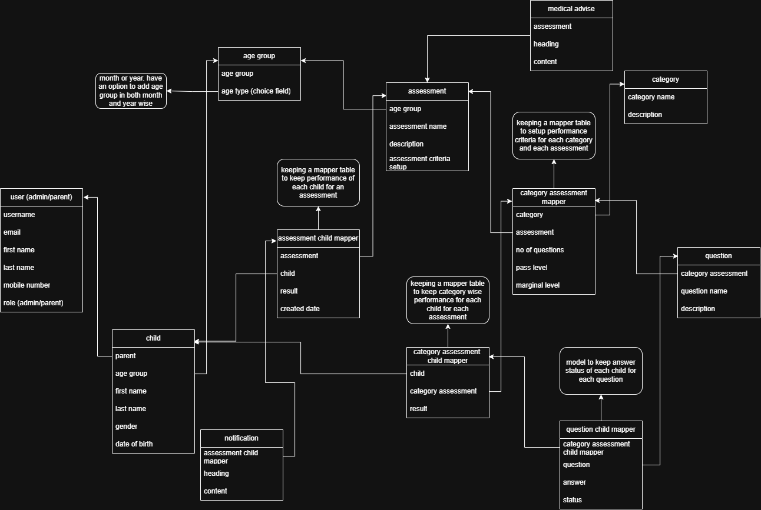

Slide 11
Database : Screening_app
Table_name : parent_child
FIELD NAME | DATA TYPE | DESCRIPTION | CONSTRAINTS
id | UUID | Unique Identifier | Primary Key
parent_id | UUID | Reference to the parent (CustomUser) | Foreign Key
age_group_id | UUID | Reference to the child's age group | Foreign Key
first_name | VARCHAR | First name of the child | Not Null
last_name | VARCHAR | Last name of the child | Not Null
dob | DATE | Date of birth of the child | Not Null
gender | VARCHAR | Gender of the child | Check (Male/Female/Others)
profile_pic | TEXT | URL of the child's profile picture | Nullable

Slide 12
Table_name : CategoryAssessmentChildMapper
Column Name | Data Type | Length | Description | Constraints
id | UUID | - | Unique identifier for the record | Primary Key
child_mapper_id | UUID | - | Reference to the child | Foreign Key
category_assessment_mapper | UUID | - | Reference to category assessment | Foreign Key
result | VARCHAR | 250 | Result of the category assessment | Not Null
Table_name : AssessmentChildMapper
Column Name | Data Type | Length | Description | Constraints
id | UUID | - | Unique identifier for the record | Primary Key
assessment_mapper_id | UUID | - | Reference to an assessment | Foreign Key
child_mapper_id | UUID | - | Reference to the child | Foreign Key
result | VARCHAR | 250 | Result of the assessment (Pass/Marginal/Failed) | Not Null

Slide 13
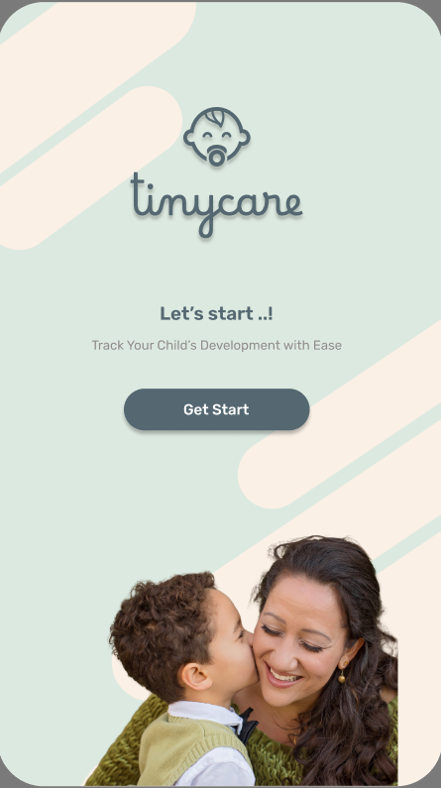
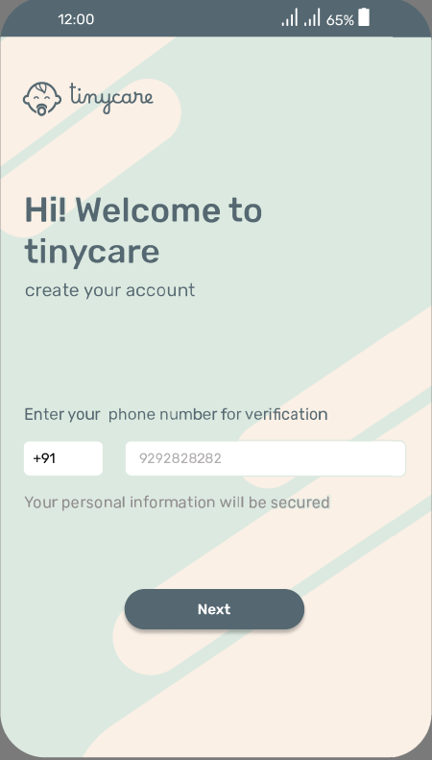
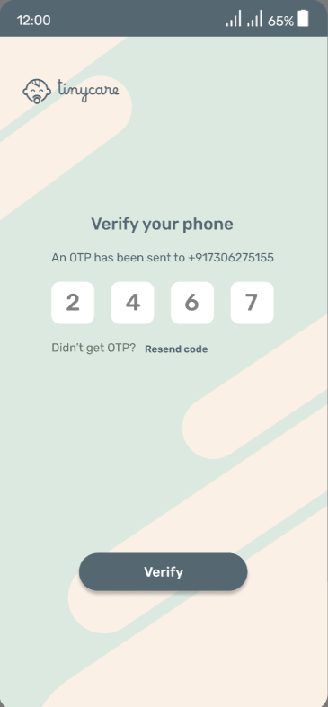

Slide 14
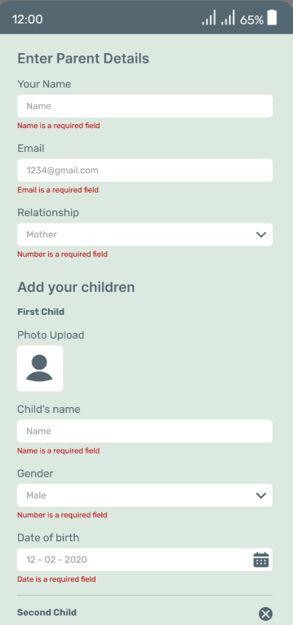
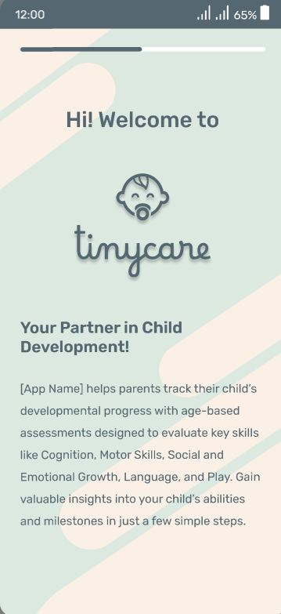
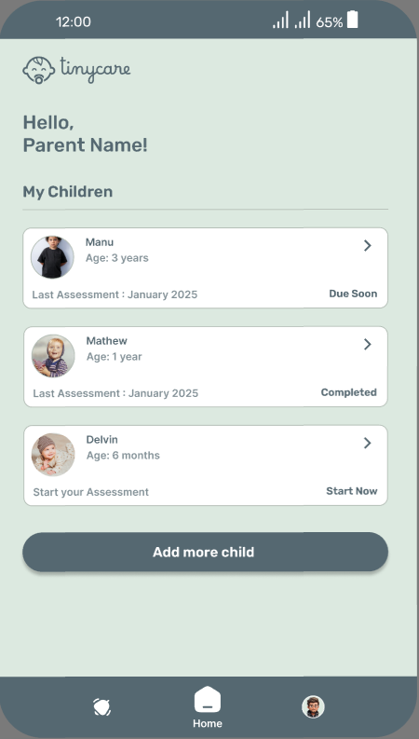

Slide 15
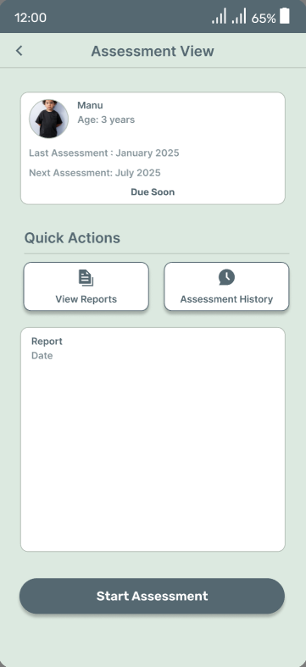
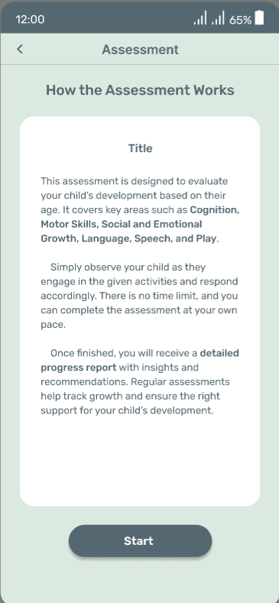
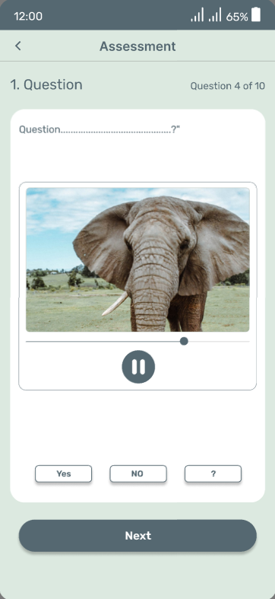

Slide 16
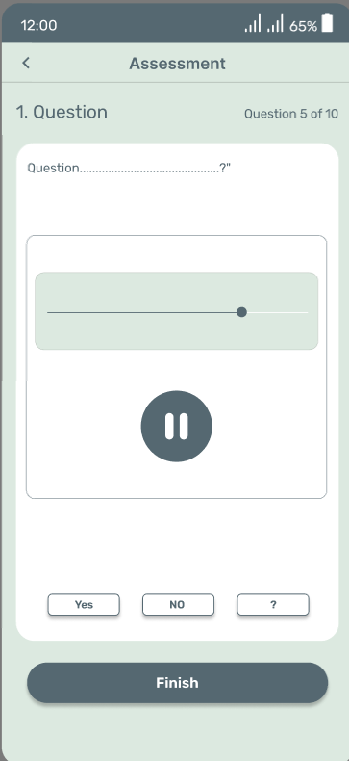
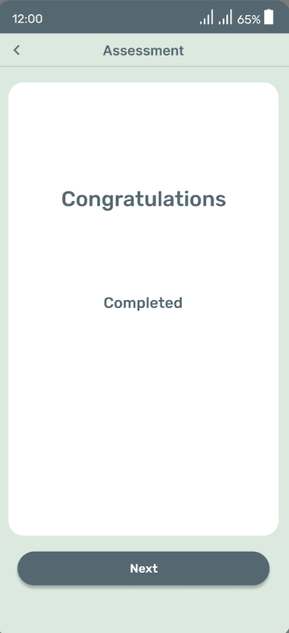
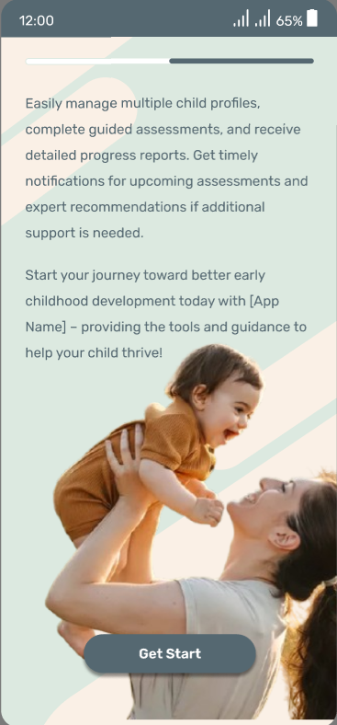

Slide 17
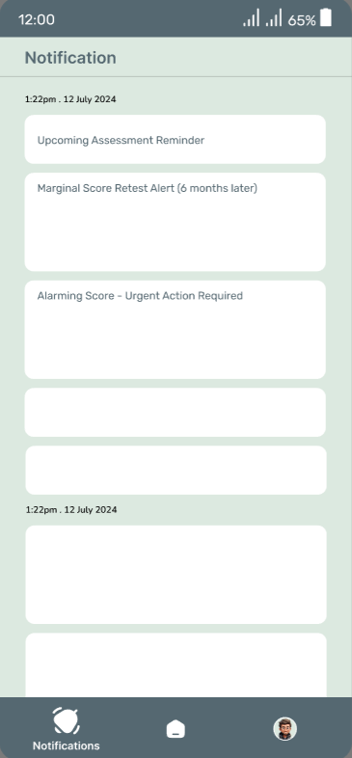
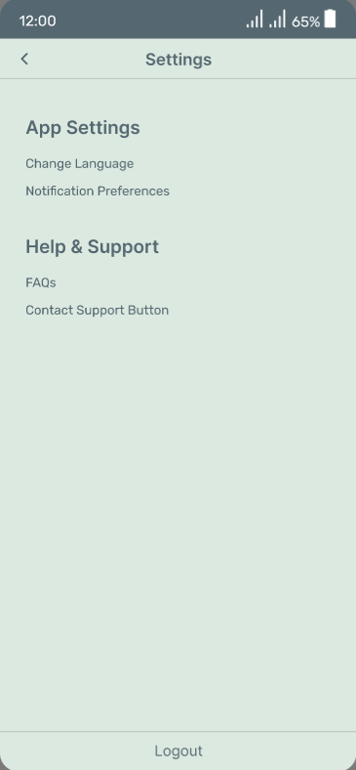
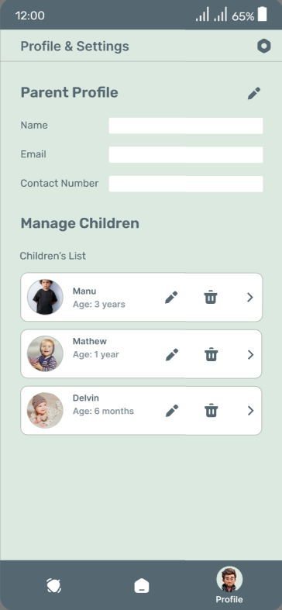

Slide 18

THANK YOU»»

